Slide 1
Basics of R
Go to
04 - Practical Session on R →
Session I - Basics of R →
Open “Basics of R.R” with RStudio
Run each line by pressing Ctrl + Enter

Slide 2
Regression Modeling with R Coding
Go to
04 - Practical Session on R →
Session II - Regression →
01 - Run each model →
Explore regressionDataSet.csv
Open randomForest.R with RStudio

Slide 3
Regression Modeling with R Coding
Open & Explore decisionTree.R
Open & Explore linearModel.R
Open & Explore neuralNetwork.R

Slide 4
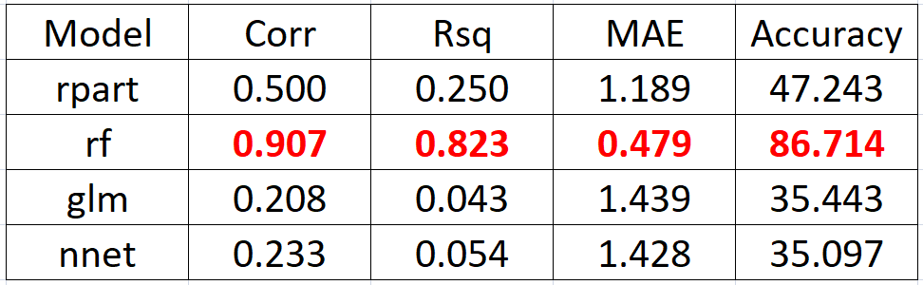
Regression Modeling with R Coding
WAP in R to merge all the results into a single file as given below:

Slide 5
Paper writing on Regression
Go to
04 - Practical Session on R →
Session II - Regression →
Open Regression Paper.pdf

Slide 6
Testing of new Data Set
Go to
04 - Practical Session on R →
Session III - Testing of New DataSet →
Explore
testFile1.csv
testFile2.csv

Slide 7
Testing of new Data Set
Go to
Copy the trained model in →
Session III - Testing of New DataSet
Open
testingNewDataSet.R

Slide 8
Testing of new Data Set in Rattle
Testing of new Data Set in Rattle….

Slide 9
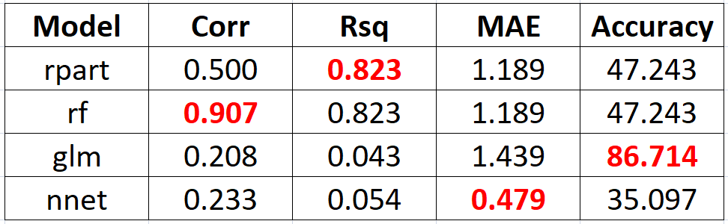
Multi Decision Criteria

Slide 10
Multi Decision Criteria
TOPSIS
Technique for Order of Preference by Similarity to Ideal Solution (TOPSIS).
It is a multi-criteria decision analysis method, which was originally developed by Hwang and Yoon in 1981 with further developments by Yoon in 1987, and Hwang, Lai and Liu in 1993.

Slide 11
Multi Decision Criteria
Install TOPSIS
install.packages(‘topsis’)
Open RStudio
Go to help & search for topsis
Explore example
Copy example and run in Rstudio.

Slide 12
Multi Decision Criteria
Application ???

Slide 13
Multi Decision Criteria
Image Pritization

Slide 14
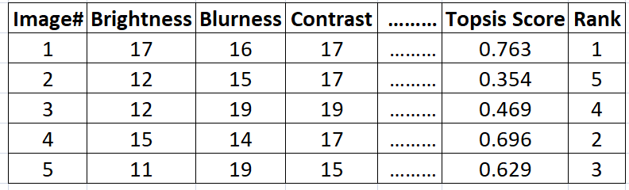
Multi Decision Criteria
Image Pritization

Slide 15
Multi Decision Criteria
Problem Statement
There are ten thousand folders and every folder contain 6-8 images of the same object. Find the best two images from each folder.

Slide 16
Multi Decision Criteria
Project Idea ?
Photo Hackthon

Slide 17
Multi Decision Criteria
Project Idea ?
Song Hackthon

